Slide 1
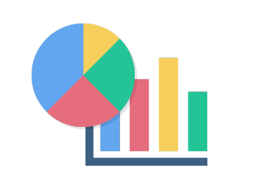



Twitter scraping
with Twint
Transformations with pandas and pdpipe
DataViz with Plotly and seaborn
Reporting with DataPane

